Slide 1

Crime Trends in the Atlanta Area
The DATAMANIACS:
Kelly Cash, Joe Kim, Betsy James, Grace Sun, Sophie Qiao

Slide 2


Overview
Do any general trends exist regarding crime in the Atlanta area?
Types of crimes committed
Time of day
Seasons of the year
Neighborhoods
Did general trends change in 2020 during the pandemic?

Slide 3

Data Cleanup & Exploration
Data obtained from Atlanta Police Department (https://www.atlantapd.org/) Raw Crime Data Download (2009-2020)
Cleaning process
Challenges
Three csv files across years
Unmatching columns/headings
Formatting: dates, times
Bad data
Years
Duplicates
Uncooperative cells

Slide 4
Data Analysis
Multiple slides here of our graphs and cool findings

Slide 5
Discussion/Conclusions

Slide 6
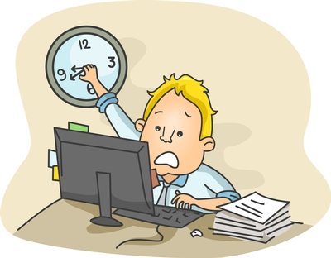
If we had more time, we would…
List of things we didn’t have time to discuss here…

Slide 7

Questions

